Slide 2
CONTENTS
Why we need to use some functional libraries?
What is the difference between Cats and Scalaz?
Comparison
History of Cats and Scalaz
Real life example

Slide 3
Why we need to use some functional libraries?
Isn’t Scala already a functional language?
Scala is already functional, but a lot of the machinery for doing pure functional programming is missing in the standard library. Plenty of people do heavy FP without Scalaz or Cats, but eventually you may find yourself reinventing some of the things those libraries provide.
Mutable variables as first-class citizens of the language
Uncontrolled side-effects (ties in with the first point)
Mutable collections and other imperative libraries exist on equal footing
Object-oriented structures (class inheritance, overloading, etc)
Verbosity

Slide 4
What is the difference between Cats and Scalaz?
Cats and Scalaz have the same goal: to facilitate pure functional programming in Scala applications.
Scalaz or Cats are libraries, think of them like a swiss army knife. You may only need one or two core data structures, or you may want to use tons of them, it really depends on the problem. My gateway drug into using Scalaz was needing to easily work with Future[Option[String]] types, without having to nest maps. Those are called Monad Transformers, and make life easier.

Slide 5
More about Cats Goals
Small
Modular
Friendly to newcomers
Efficient
Not willing to compromise on Principals
Willing to compromise on Principals
Clean, consistent source code
Everything is serializable
Scaladoc all the thing

Slide 6
Comparison
ScalaZ
Started: 2009
Cats:
Started: 2015
Project | Releases | Watchers | Stars | Forks | Commits | Prev. Month Commits
Scalaz | 128 | 276 | 4030 | 680 | 6523 | 8
Cats | 35 | 206 | 3024 | 764 | 3878 | 82

Slide 7
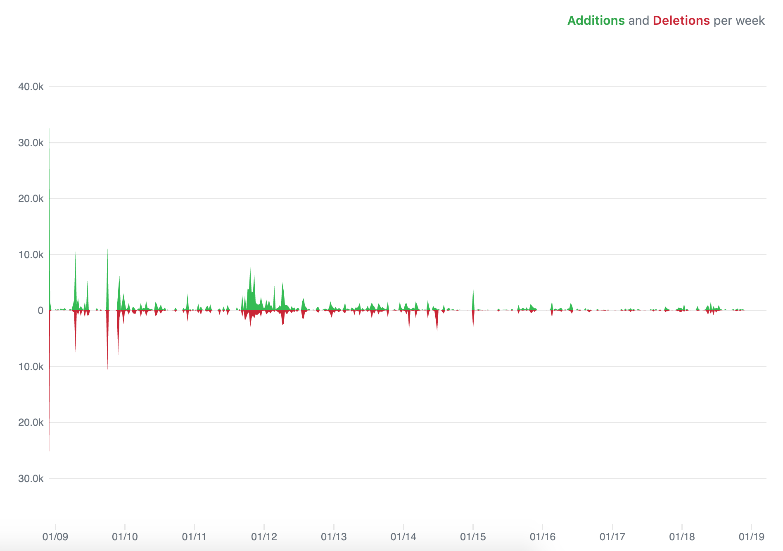
Scalaz

Slide 8

Cats

Slide 9
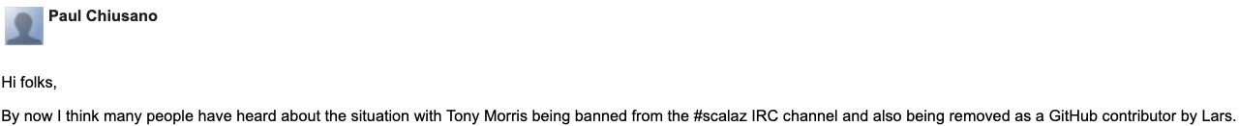
Unhappy ending story about Scalaz
Project stared by Tony before 2007 gathered a lot of contributors. Many of them are/was most known members of Scala community. One of them was Lars Hupel, who eventually became one of the most important contributors responsible for releases.
Somewhere around 2014 Lars banned Tony from channel he himself established.
Source: https://groups.google.com/forum/m/#!topic/scalaz/EBP_7sfB2ks
https://twitter.com/travisbrown/status/620444367145316353

Slide 10

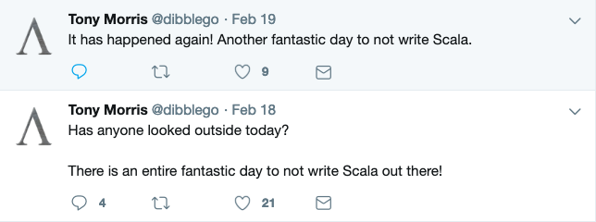
Tony Morris

Slide 11

Lars Hupel

Slide 12
Thanks for contribution
Bottom line is, Cats and Scalaz ecosystems fulfill the same role, and the only reason 2 of them exist in separation, is that relationship of some people core to the development broke down. It is also clear, that all the sides involved (no matter what they do now and how they feel about each other), had huge contribution the the community and current Scala would not be possible without them.

Slide 13
Problem
Future[A] comes up a lot in Scala.
You don’t want to block future, so you end up with Future everywhere.
Since Future is asynchronous, any errors need to be captured in there.
Future is designed to handle Throwable, but that’s all you get.
When the program becomes complex enough, you want to type your own error states.
How can we make Future of Either?

Slide 14
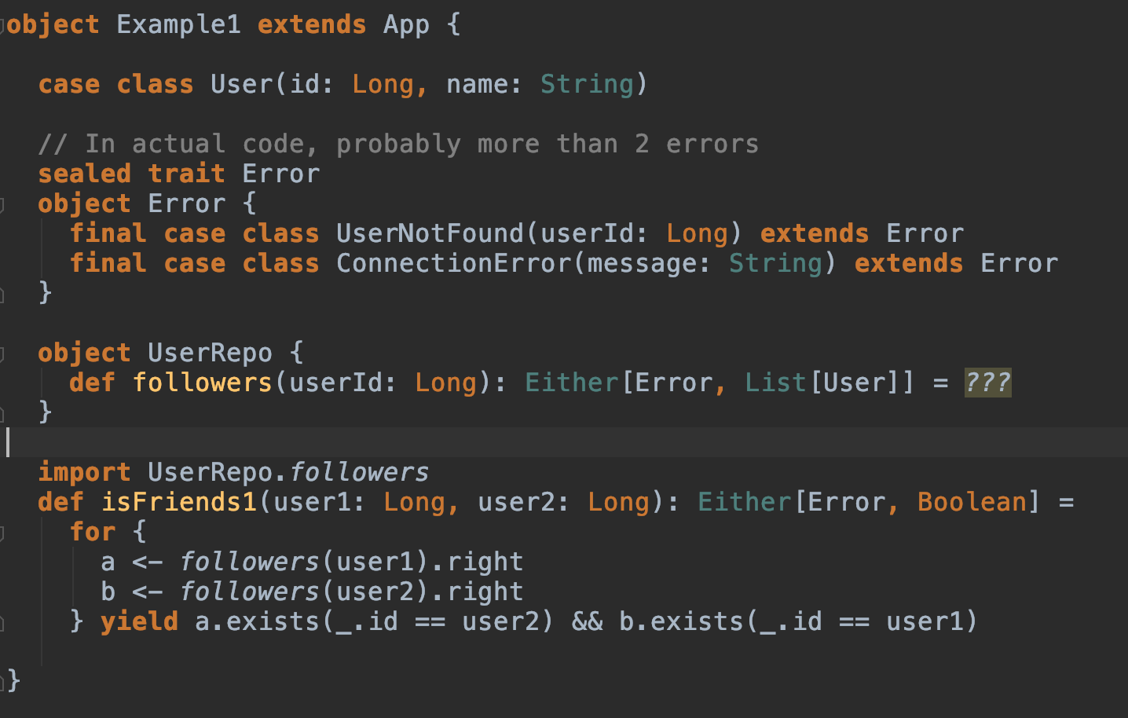
Example #1

Slide 15
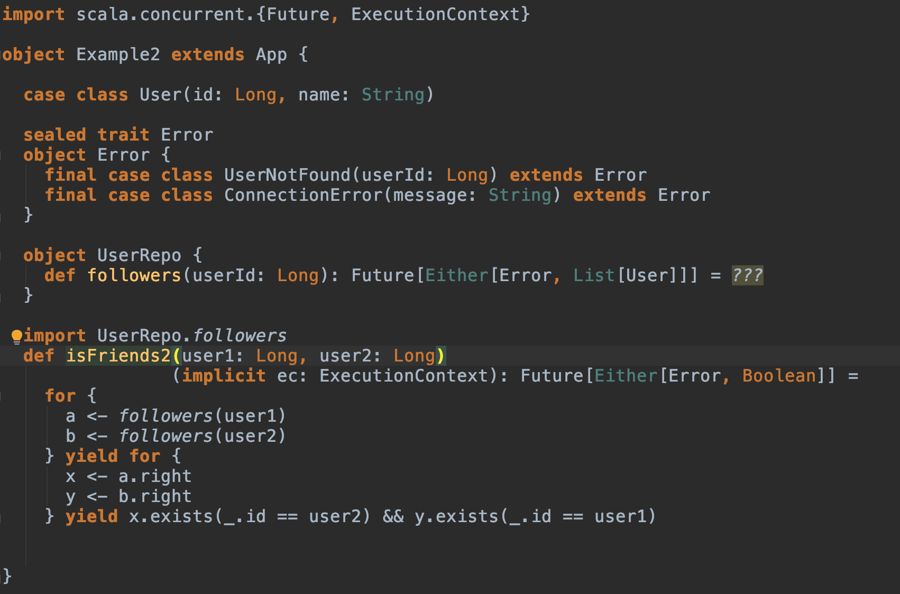
Example #2

Slide 16
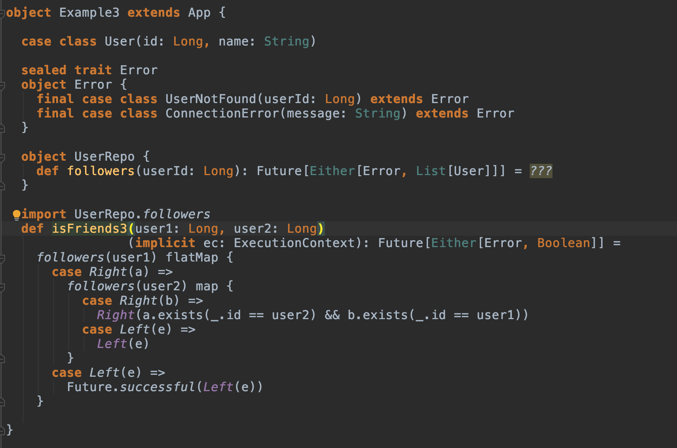
Example #3

Slide 17
Monad Transformers

Slide 18
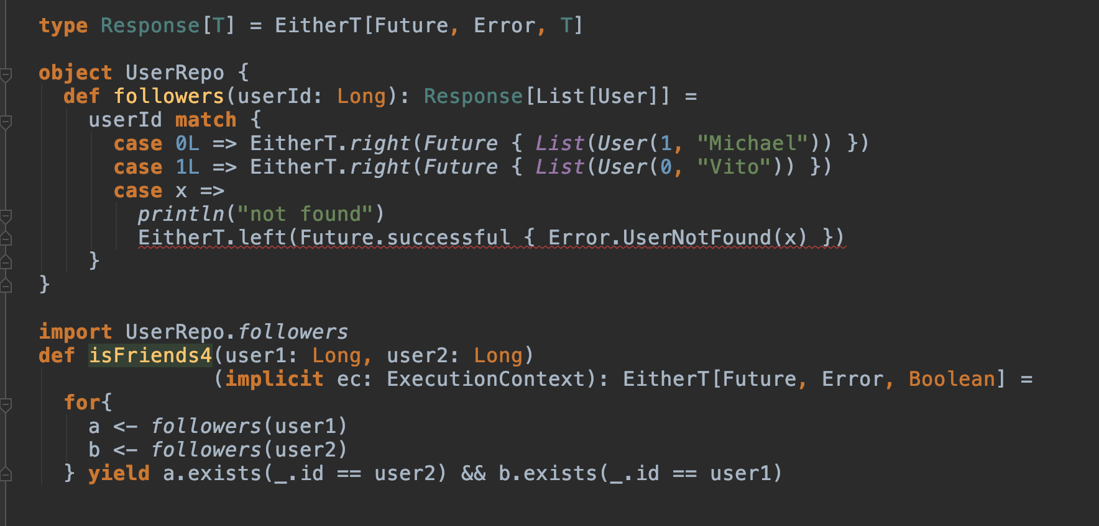
Example #4

Slide 19
Back to basics

Slide 20
Functor
trait Functor[F[_]] {
def map[A,B](fa: F[A])(f: A => B): F[B]
}
If you have been using Lists, Options, Eithers, Futures in Scala, you have been using functors.

Slide 21
Functor

Slide 22
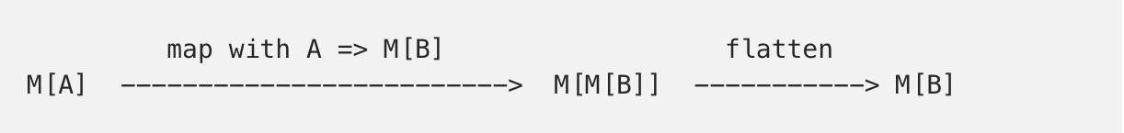
Monad
flatMap: (A => M[B]) => M[B]

Slide 23
Monads in Cats
trait Monad[F[_]] {
def pure[A](a: A): F[A]
def flatMap[A, B](fa: F[A])(f: A => F[B]): F[B]
def map[A, B](fa: F[A])(f: A => B): F[B] = {
flatMap(fa)(a => pure(f(a)))
}
}

Slide 24
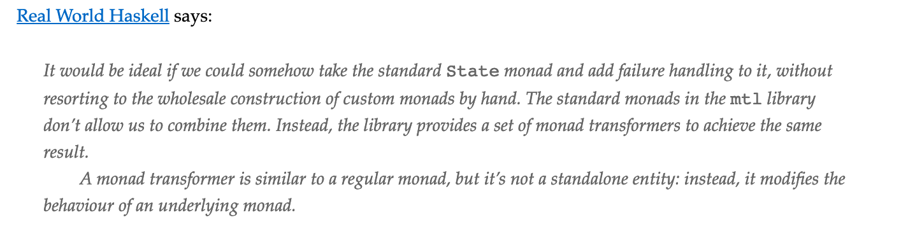
Monad transformers

Slide 25
Monad Transformers in Cats
cats.data.OptionT for Option;
cats.data.EitherT for Either;
cats.data.ReaderT for Reader;
cats.data.WriterT for Writer;
cats.data.StateT for State;
cats.data.IdT for the Id monad.

Slide 26
Tips about using cats
Extension method constructors
Cartesian
Utility functions: Lift, mapN, traverse, pure
IO (Task) instead of Futures
Custom Typeclasses
Typelevel ecosystem: http4s, cats, cats-effect, circe, fs2, doobie, Matryoshka

Slide 27
Extension methods constructors
.some, and the corresponding none constructor method for Option
.asRight, .asLeft for Either,
.valid, .invalid, .validNel, .invalidNel for Validated
import cats.implicits._
Some("a")
//Some[String]
"a".some
//Option[String]
.asRight and .asLeft still have one type parameter. For example, "1".asRight[Int] is Either[Int, String]. If you do not provide that parameter, the compiler will try to infer it, and may come up with Nothing

Slide 28
Cartesian builder syntax
for {
value <- intFuture
contents <- stringFuture
user <- userFuture
} yield process(value, contents, user)
Vs
(intFuture |@| stringFuture |@| userFuture).map(process)

Slide 29
Lift function
import cats.data.EitherT
import cats.implicits._
EitherT.liftF("a".some)
//EitherT(Some(Right(a)))
EitherT.liftF(none[String])
//EitherT(None)
Example: https://scalafiddle.io/sf/K1TqcWQ/3

Slide 30
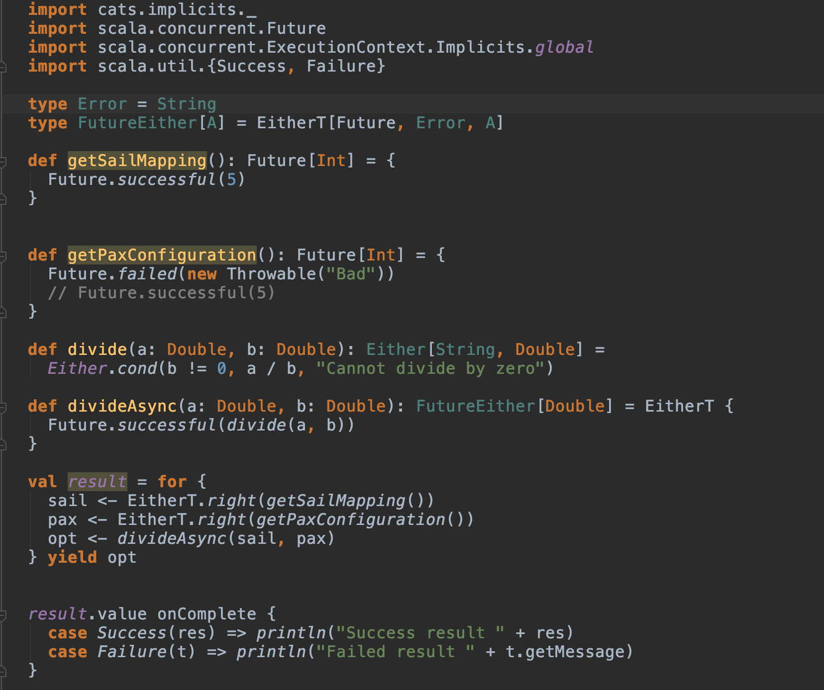
Right vs Lift

Slide 31
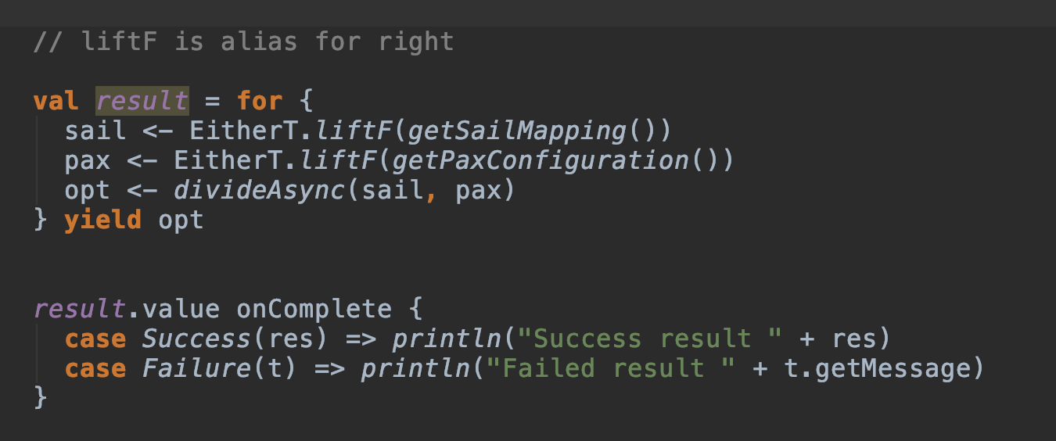
Right vs Lift

Slide 32
mapN
import cats.implicits._
("a".some, "b".some).mapN(_ ++ _)
//Some(ab)
(List(1, 2), List(3, 4), List(0, 2).mapN(_ * _ * _))
//List(0, 6, 0, 8, 0, 12, 0, 16)
("a".some, List("b","c").mapN(_ ++ _))
//won't compile, because outer type is not the same
Yet another thing that .mapN helps out with is instantiating case classes:
case class Cats(name: String, color: String, age: Int)
("meow".some, "white".some, 3.some).mapN(Mead)
//Some(Cats(meow,white,3))

Slide 33
Traversing
import cats.syntax.traverse._
import cats.instances.future._
import cats.instances.list._
traverse
def updateUser(user: User): Future[User] = {
/* call some external service etc. */
}
def updateUsers(users: List[User]): Future[List[User]] = {
users.traverse(updateUser)
}
sequence
val foo: List[Future[String]] = List(Future("hello"), Future("world"))
val bar = foo.sequence // will have Future[List[String]] type

Slide 34
Traversing
flatTraverse
import cats.syntax.traverse._
import cats.instances.future._
import cats.instances.option._
val valueOpt: Option[Int] = /* ... */
def compute(value: Int): Future[Option[Int]] = { /* ... */ }
valueOpt.traverse(compute) // has type Future[Option[Option[Int]]], not good
The solution could be to map the result with a _.flatten call like:
valueOpt.traverse(compute).map(_.flatten) // has type Future[Option[Int]]
valueOpt.flatTraverse(compute) // also Future[Option[Int]]!

Slide 35
Tips

Slide 36
THANK YOU

Slide 37
Links
https://github.com/fosskers/scalaz-and-cats
https://github.com/Bunyod/IntroToCats
Scala with Cats by Noel Welsh and Dave Gurnell (assumes 1+ years of Scala experience)
Cats website - https://typelevel.org/cats/
Herding Cats by Eugene Yokota (blog series) - http://eed3si9n.com/herding-cats/

